Slide 1
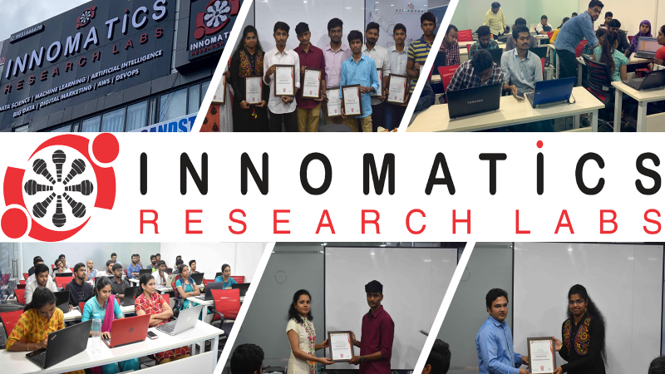

Slide 2
About me:
NAME: KONKUMUTTI SAI KRISHNA
QUALIFICATION: B.TECH(MECHANICAL)

Slide 3
EXPLORATORY DATA ANALYSIS ON AMCAT-2015
Problem Statement:
ANALYSIS OF SALARY,DESIGNATION,JOBCITY,DEGREE,COLLEGE GPA,GRADUATION YEAR,SPECIALIZATION.

Slide 4
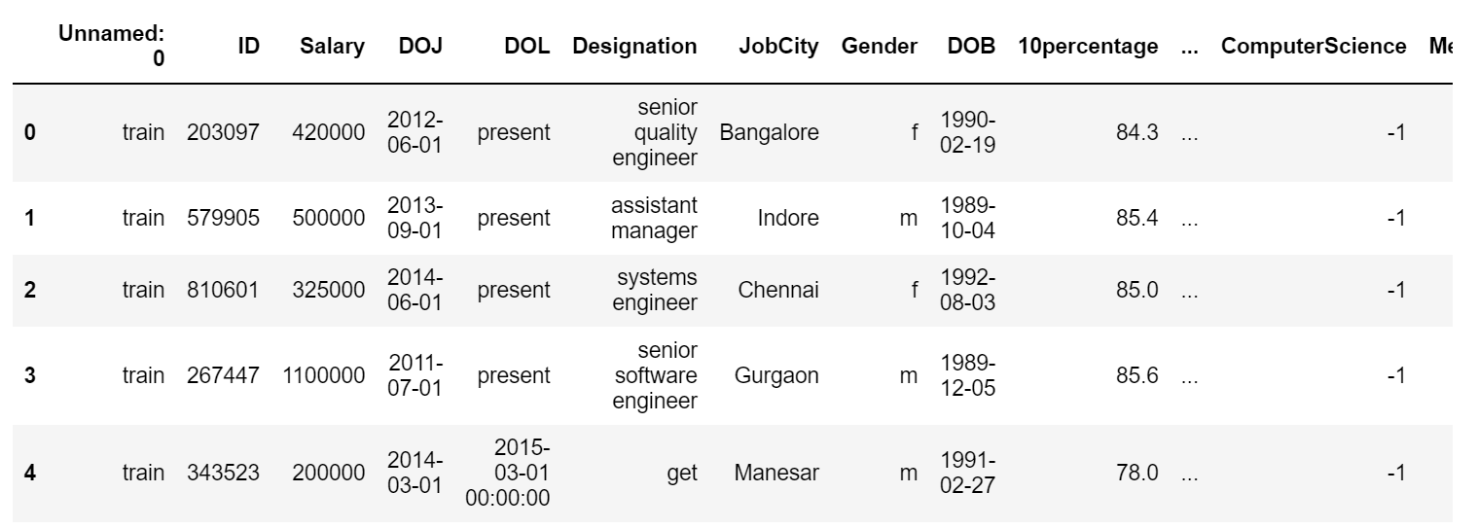
DATA FRAME:

Slide 5
DATA CLEANING
Identifying Null Values.
Identifying Missing values
Treating rows and columns with null values and missing values.
Observing the duplicates in each column
Treating duplicates by replacing
Removing unnecessary columns

Slide 6
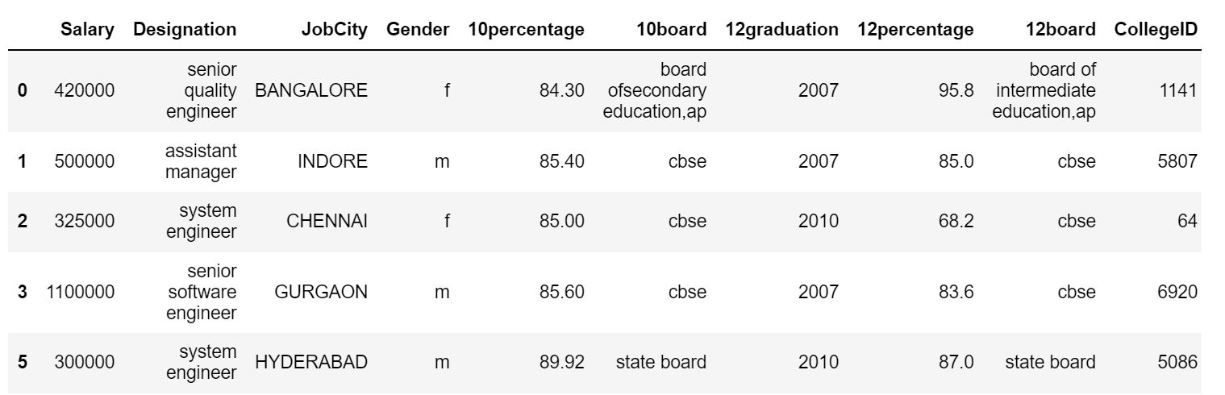
DATAFRAME AFTER DATA CLEANING AND MANIPULATION

Slide 7
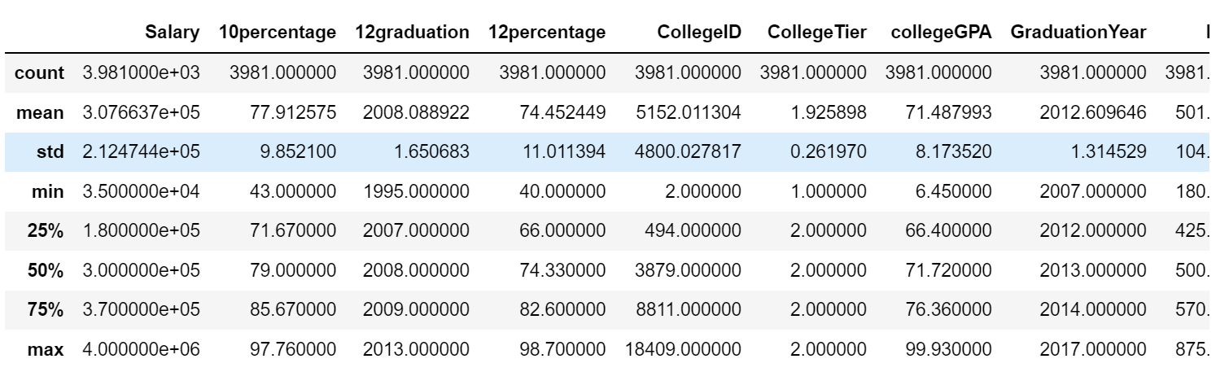
STATISTICS OF DATAFRAME

Slide 8
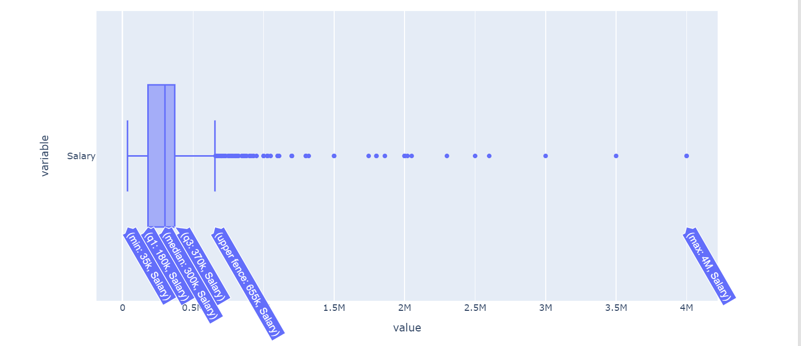
UNI-VARIATE ANALYSIS ON SALARY
THE MOST OF THE SALARIES ARE RANGE BETWEEN 180000 TO 370000.
THE HIGHEST SALARY IS 40 LAKHS.

Slide 9
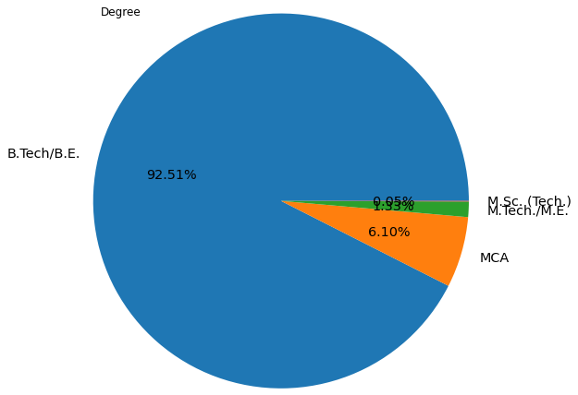
UNI-VARIATE ANALYSIS ON DEGREE
B.TECH/B.E STUDENTS ARE GIVING MORE AMCAT EXAM.
THE LEAST STUDENTS FROM M.SC GIVING AMCAT EXAM

Slide 10
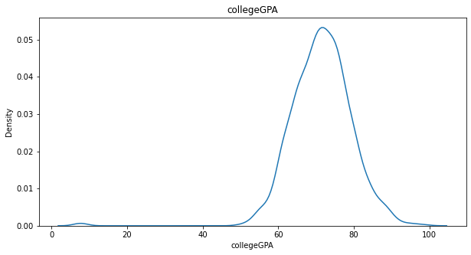
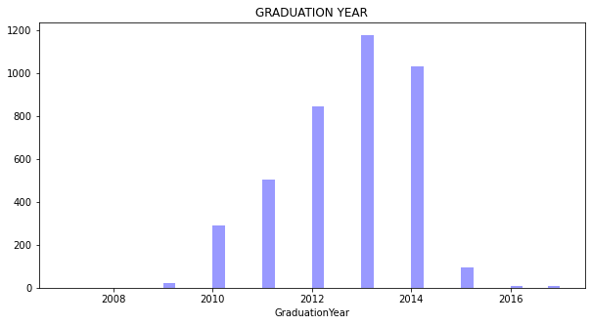
THE MOST OF COLLEGE GPA ARE RANGE BETWEEN 50 TO 80.
MOST OF THE STUDENTS HAVE MORE COLLEGEGPA.
THE MOST OF THE GRADUATES ARE FROM 2013 and 2014.
THE LEAST GRADUATES ARE FROM 2007.

Slide 11
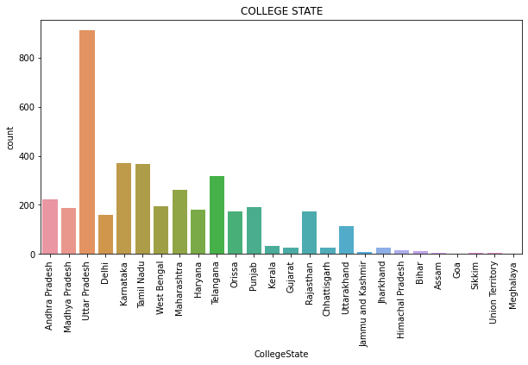
UNI-VARIATE ANALYSIS ON COLLEGE STATE
THE MOST OF THE GRADUATES ARE FROM UTTAR PRADESH,KARNATAKA,TAMIL NADU AND TELANGANA.
THE LEAST OF THE GRADUATES ARE FROM GOA,MEGHALAYA AND SIKKIM.

Slide 12
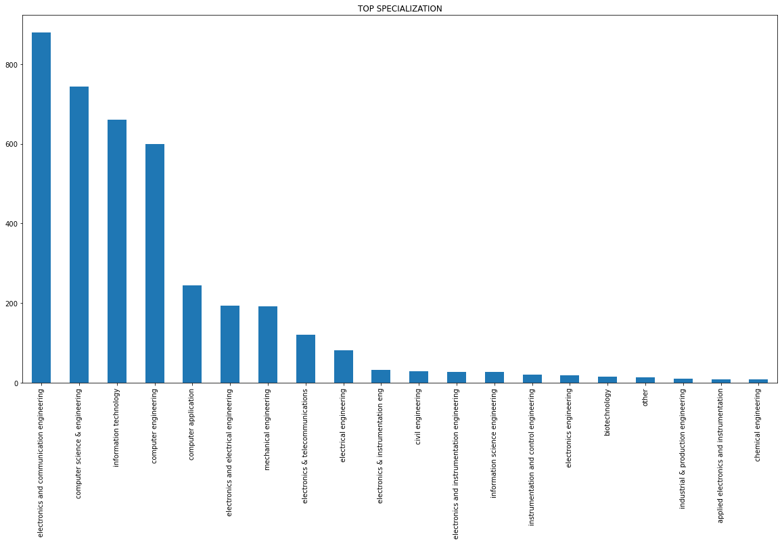
UNI-VARIATE ANALYSIS ON TOP SPECIALIZATION
THE ELECTRONICS AND COMMUNICATION ENGINEERING,COMPUTER SCIENCE & ENGINNERING,INFORMATION TECHNOLOGY HAVE MORE STUDENTS IN THE SPECIALIZATION.
CHEMICAL ENGINEERING HAS LESS STUDENTS IN THE SPECIALIZATION.

Slide 13
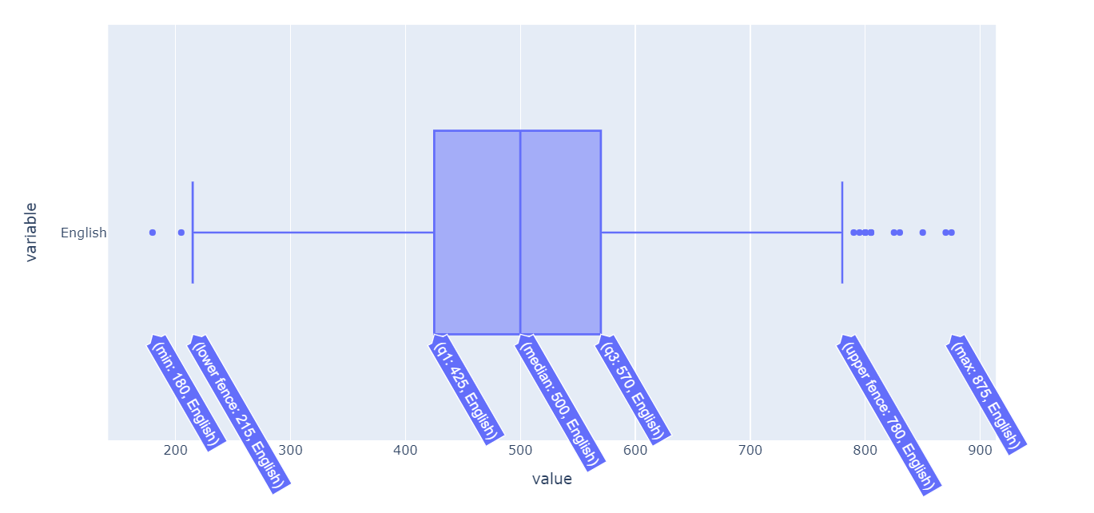
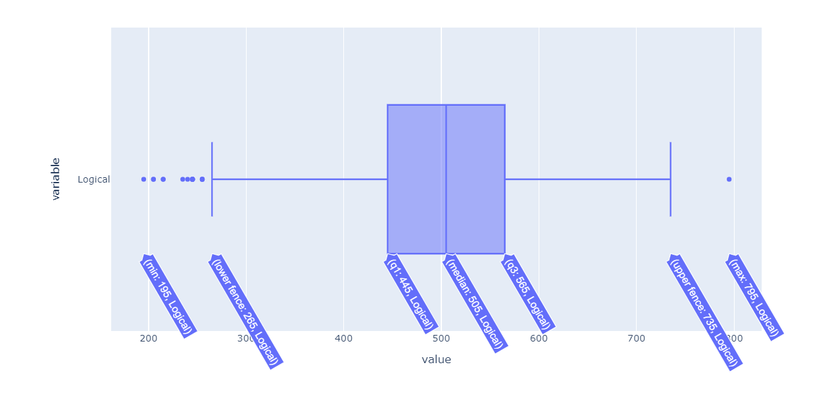
THE MOST OF THE ENGISH MARKS RANGE IS BETWEN 425 TO 570.
THE LEAST VALUE IS 180.
THE HIGHEST VALUE IS 875.
THE MOST OF THE LOGICAL MARKS RANGE IS BETWEN 445 TO 565.
THE LEAST VALUE IS 195.
THE HIGHEST VALUE IS 795.

Slide 14
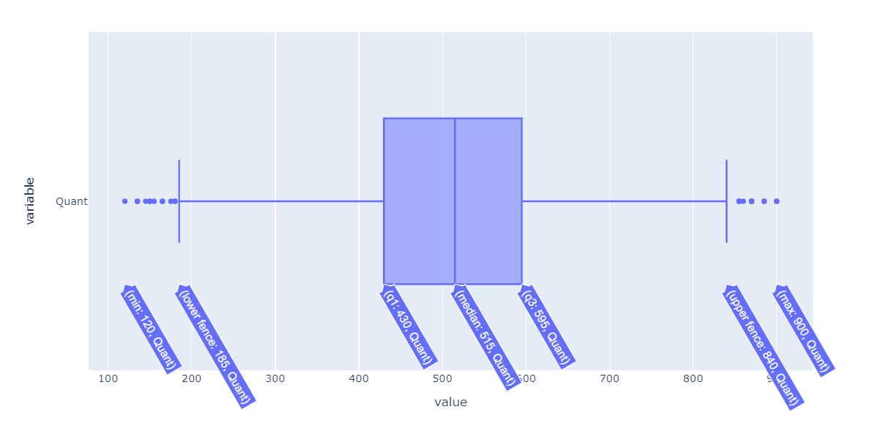
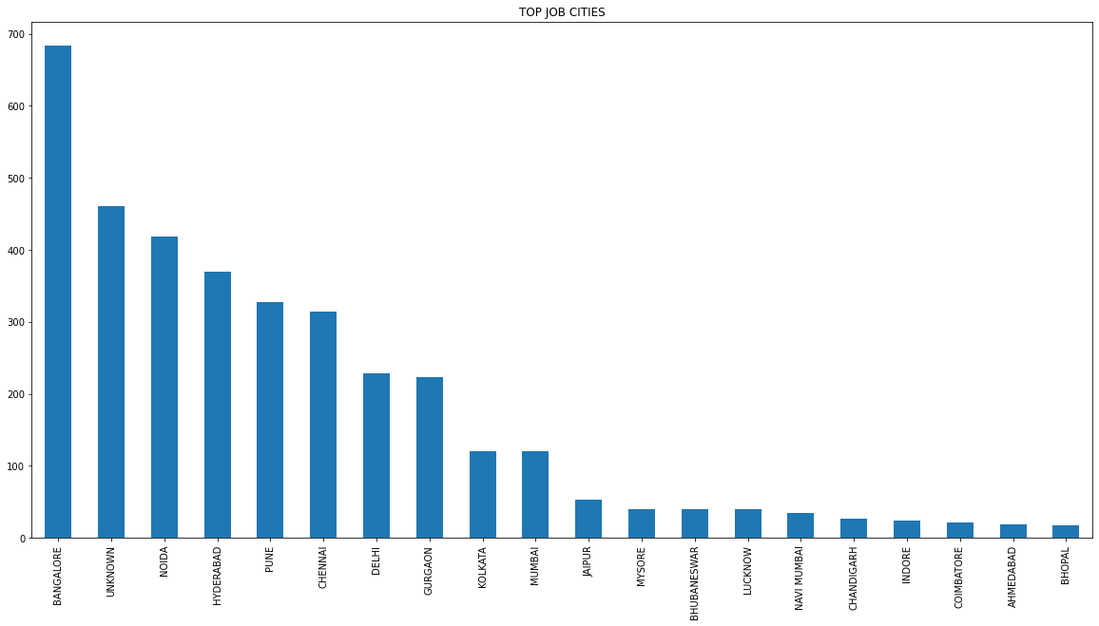
THE MOST OF THE QUANT RANGE IS BETWEN 430 TO 595.
THE LEAST VALUE IS 120.
THE HIGHEST VALUE IS 900.
BANGOLORE,NOIDA,HYDERABAD,PUNE,CHENNAI ARE THE HIGHEST JOB CITIES.
COIMBATORE AND AHMEDABAD,BHOPAL ARE LESS JOB CITIES.

Slide 15
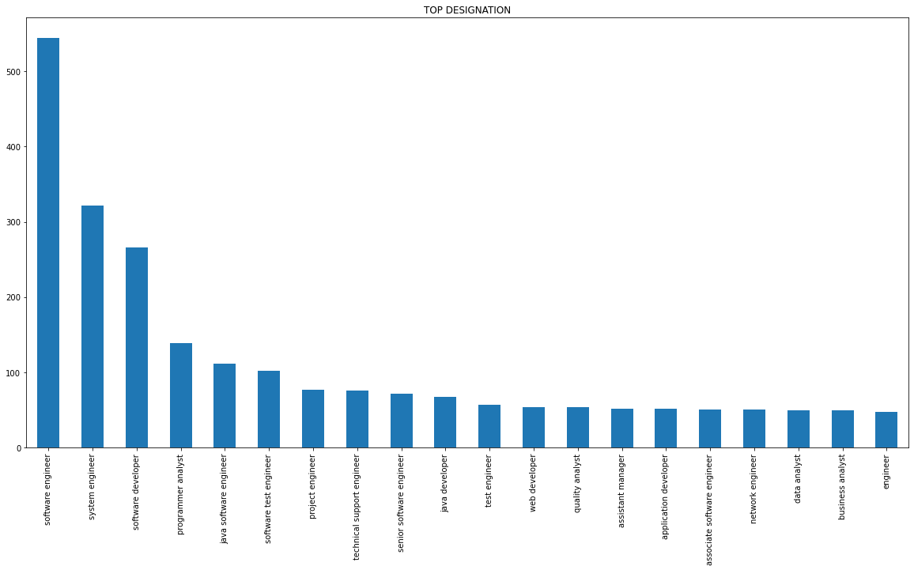
UNI-VARIATE ANALYSIS ON TOP JOB DESIGNATION
SOFTWARE ENGINEER,SYSTEM ENGINEER,SOFTWARE DEVELOPER ARE MORE IN THE DESIGNATION.

Slide 16
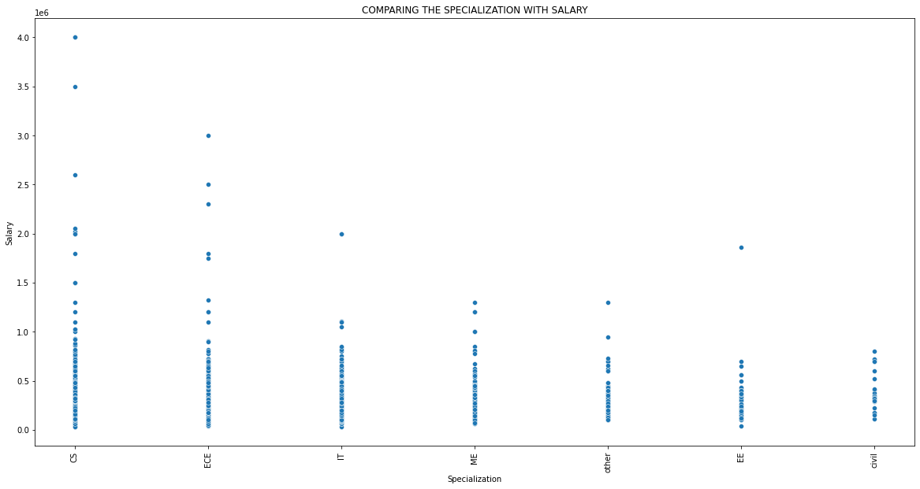
COMPARING THE SPECIALIZATION WITH SALARY
COMPUTER ENGINEERING, ELECTRONICS AND COMMUNICATION ENGINEERING, INFORMATION TECHNOLOGY AND COMPUTER SCIENCE ENGINNERING ARE HIGH SALARY

Slide 17
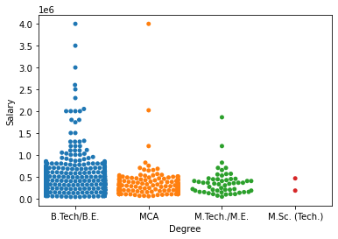
COMPARING THE DEGREE WITH SALARY
B.TECH/B.E AND MCA ARE GETTING HIGH SALARIES.
M.SC ARE GETTING LESS SALARIES.

Slide 18
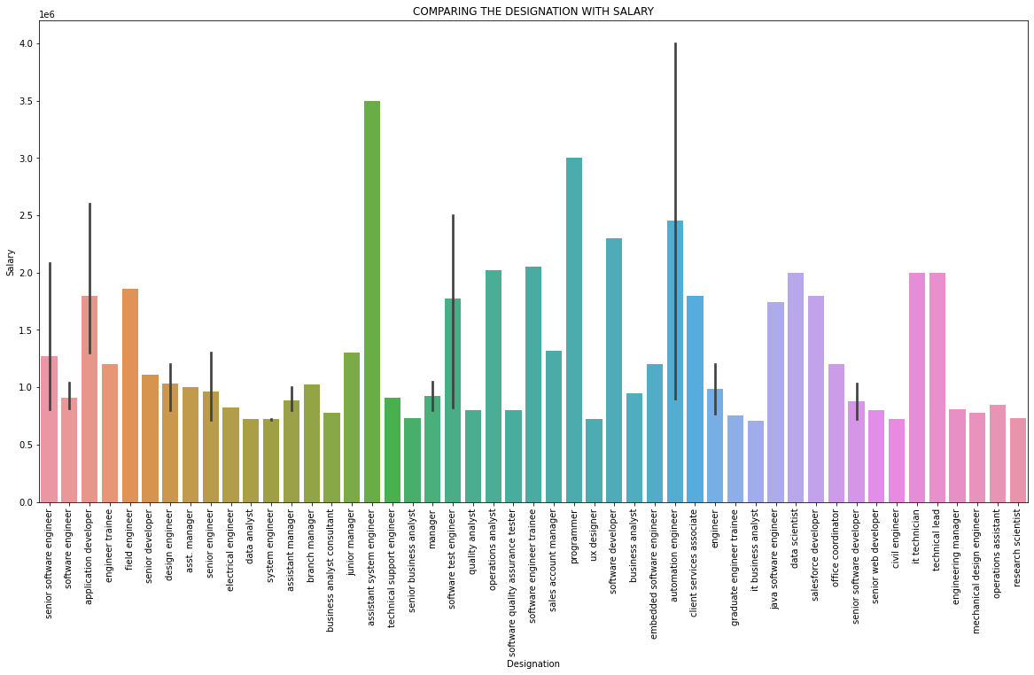
COMPARING THE DESIGNATION WITH SALARY
AUTOMATION ENGINEER AND JUNIOR MANAGER ARE GETTING HIGH SALARY

Slide 19
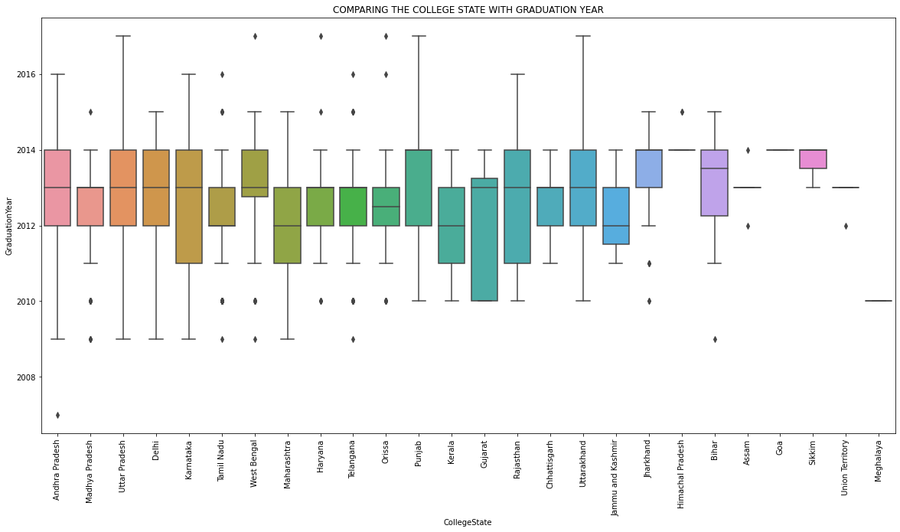
COMPARING THE COLLEGE STATE WITH GRADUATION YEAR
MOST OF THE STUDENTS ARE FROM 2010 AND 2016

Slide 20
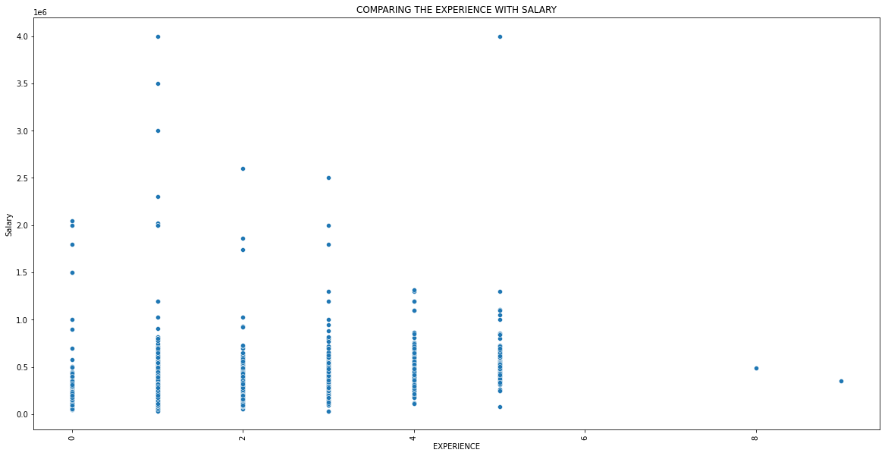
COMPARING THE EXPERIENCE WITH SALARY
1,2,3 year experience employess are high salary.

Slide 21
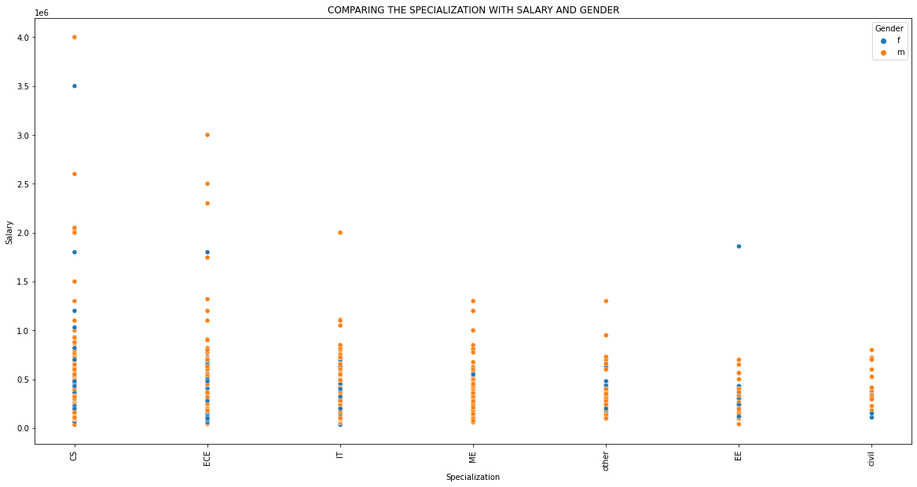
COMPARING THE SPECIALIZATION WITH SALARY AND GENDER

Slide 22
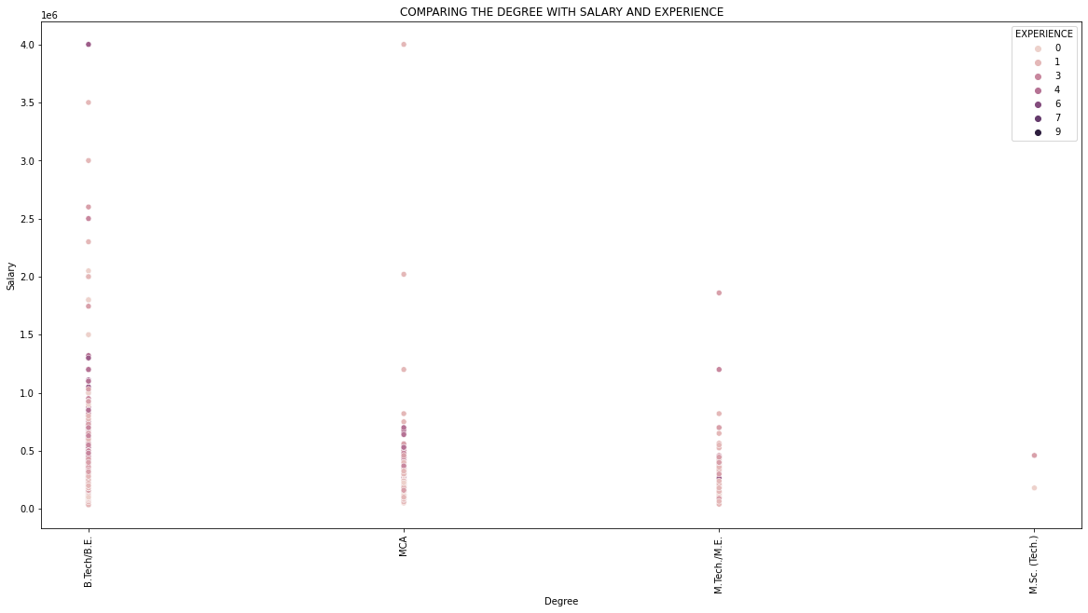
COMPARING THE DEGREE WITH SALARY AND EXPERIENCE

Slide 23
Key Business
Question

Slide 24
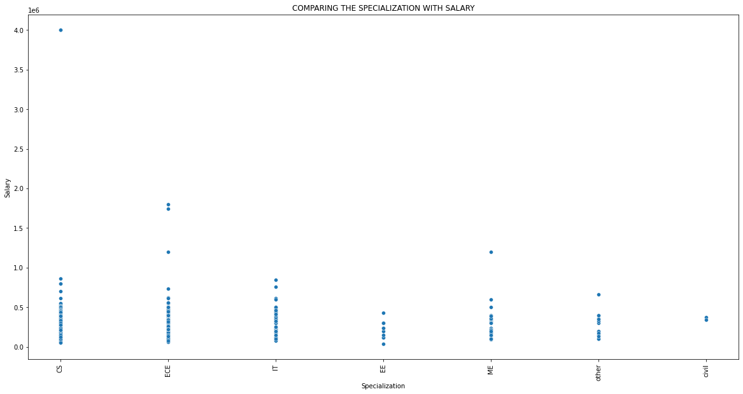

Slide 25
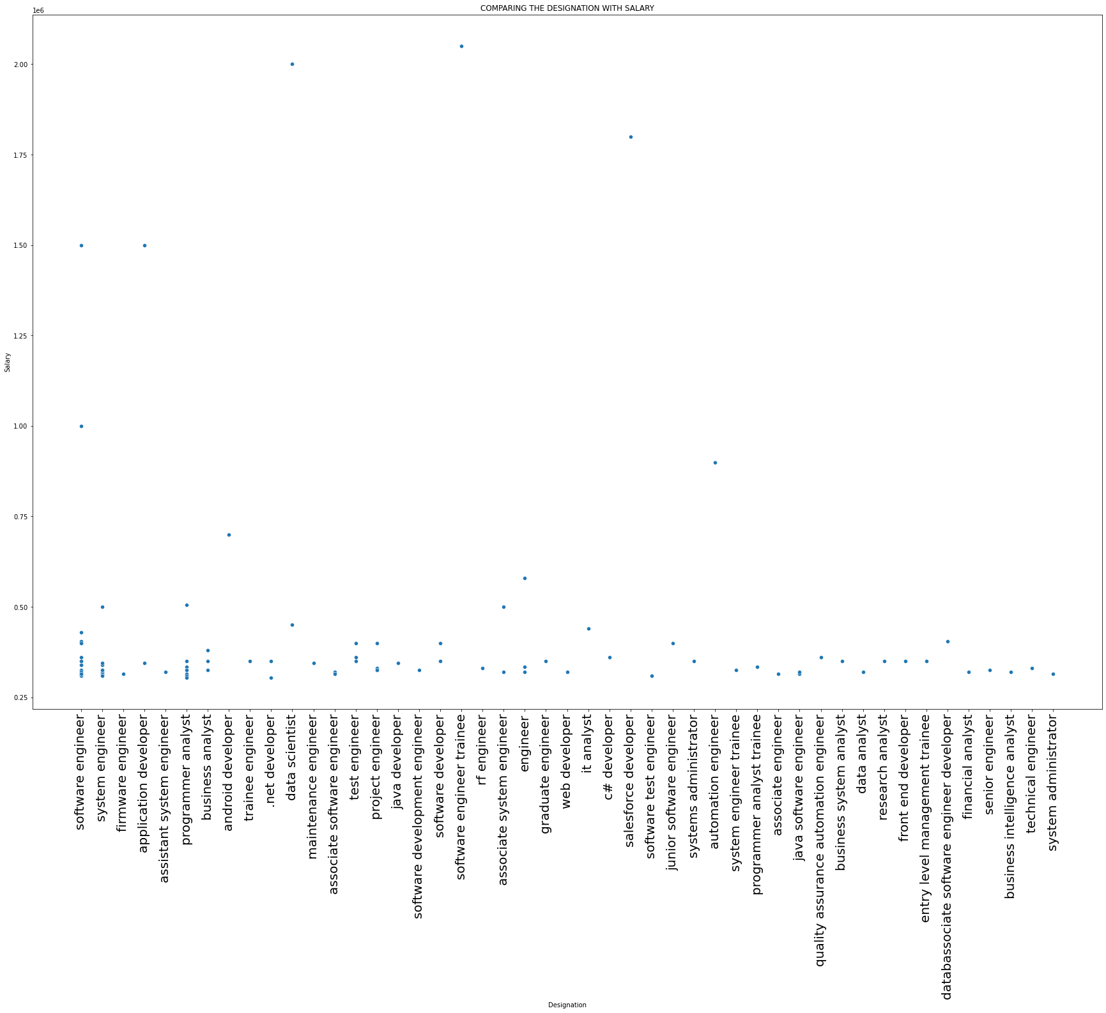

Slide 26
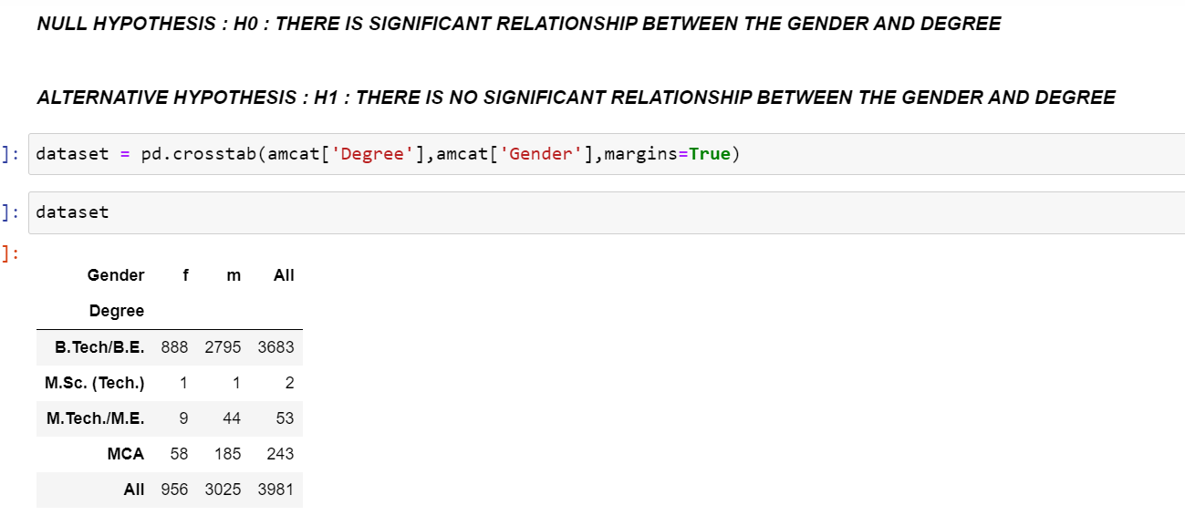
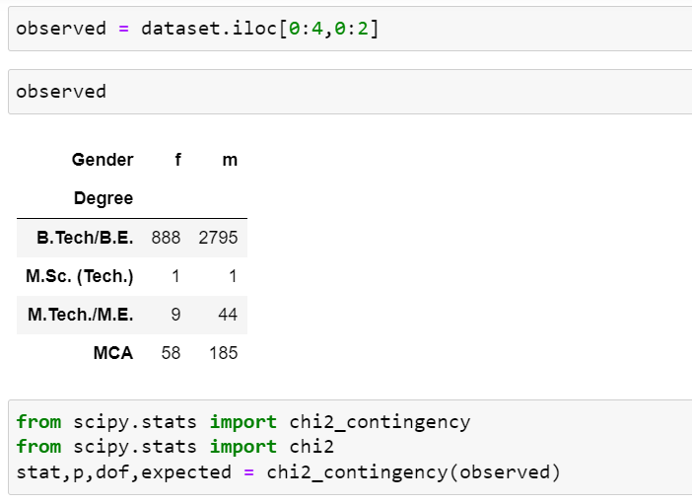

Slide 27
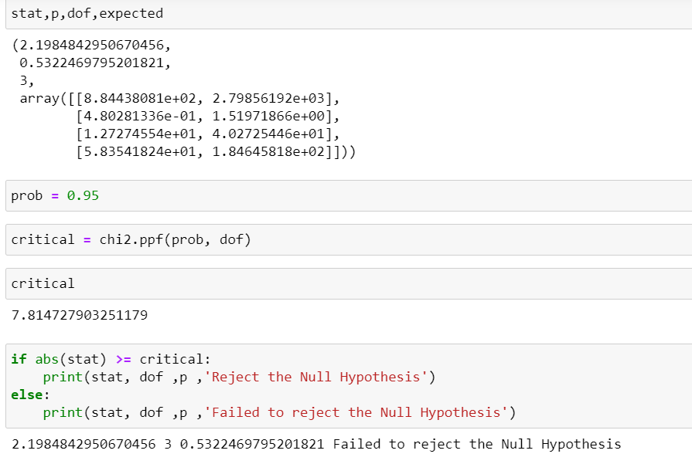

Slide 28
CONCLUSION:
Salaries are high to the CS department.
Most of the jobs are located in Bangalore.
Software engineers and software test engineers,Automation Engineer are getting high salary.
The most of the salaries are range between 180000 to 370000.
B.TECH/B.E students are giving more AMCAT exam.
The most of the graduates are from 2013 and 2014.

Slide 29

THANK
YOU

